Slide 1
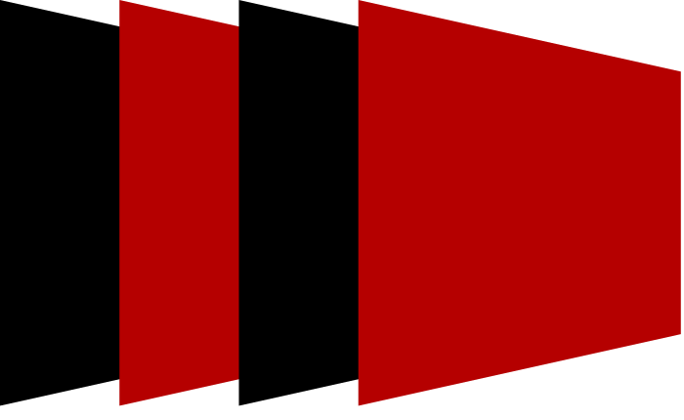
Auto-partitioning Heterogeneous Task-parallel Programs with
StreamBlocks
Mahyar Emami, Endri Bezati*,
Jörn Janneck**, James Larus
* Computing Systems Laboratory, Huawei Technologies, Zurich
** Lund University
October 2022

Slide 2
FPGA Programming is Hard!
Programming
Traditionally HDL (hardware description language)
Reserved to digital designers
Nowadays HLS-C (high-level synthesis from C/C++)
Pseudo-software programming, looks like C/C++
Hardware knowledge is a must
Steady improvements in HLS research
New Age of FPGAs ⇒ FPGAs in the cloud
Broader software engineer audience
FPGAs in the cloud as commodity accelerators
Calls for hardware-software codesign
Part of larger systems
What should be accelerated?
How to define the hardware-software boundary?
Notes:
Like 90% of works about FPGAs, our motivation is that FPGA programming is pretty tedious.
To use them you should be a digital designer and use HDLs (hardware description language) and describe your functionality at the RTL abstraction.
A decade ago HLS (high-level synthesis) tools/compilers emerged where you could write “C/C++” code and then turn it into HDL
However, hardware knowledge is still a must,
you still need to be able to write low-level code to bridge hardware and software
you still need to write all of your own libraries and also learn the starking differences between C/C++ and HLS-C
In essence HLS-C is like programming bare-metal machines where everything is up to you
However, HLS seems to be getting better and better every day
HLS is more important today than 10 years ago because of the proliferation of FPGAs in the cloud.
FPGAs are no longer reserved to hardware savvies in embedded systems, but have a broader audience.
They are being advertised as commodity accelerators and therefore there is need for hardware-software codesign
Especially now that they are part of a larger system
Research question to answer: what parts of the systems should be accelerated on FPGAs

Slide 3
Building FPGA-Accelerated Applications
The usual approach
Identify candidates for acceleration (partitioning) ⇒ hardware and software expertise required!
Write software code ⇒ C++, Java, and etc.
Write hardware code ⇒ HLS-C, OpenCL, Verilog, and etc.
Evaluate performance ⇒ if goal not met back to step 1!
StreamBlocks (our approach) ⇒ Unify hardware-software code to enable automatic partitioning
Write software/hardware code
Press compile (maybe a couple of times)
FPGA hardware-software codesign (partitioning) is a well-studied problem in the context of embedded systems but not in modern datacenter platforms

Slide 4
Outline
Unified Actor programming
Partitioning
StreamBlocks Compiler
Evaluation

Slide 5
Unified Actor Programming

Slide 6
Common Programming Model Requirements
A common abstraction should take advantage of
Thread-level parallelism on software
Spatial parallelism on hardware
Encapsulate functionality and state (CPU and FPGA do not have a shared memory)
Allow free placement of functionality on either hardware or software
The Actor model is a natural fit
Extensively used in software for concurrency
De-facto task-parallel execution model of HLS ⇒ dataflow
Notes:
A common programming model for software and hardware should be able to exploit
thread-level parallelism in software
spatial parallelism on hardware
Since in commodity cloud FPGA, there is no unified shared memory between the CPU and the FPGA
Our programming model should explicitly define boundaries at which state can be read or written
This also makes free placement of “functionality” possible on either software or hardware
What we have described has been long studied by computer scientist and has been called the Actor model.
Extensively used in software both on shared memory and distributed systems
And it is also the de-facto task-parallel execution model in HLS, though it’s called dataflow there.

Slide 7
The Actor Model
Overview
Network of concurrent actors
Reliable FIFO communication
Reactive execution
Local mutable state
Potentially cyclic
Dynamic consumption/production rates
CAL Actor Language
Been around for 20 years
Tried on both FPGA and multi-core CPUs
A CAL actor consists of
A set of fireable actions
A state machine governing action selection
if input > Th:
output ⇐ input
else:
⇐ input
File() ⇐ Input
FIFO
output ⇐ Rand()
if input ≤ Th:
output ⇐ input
else:
⇐ input
File() ⇐ Input
Notes:
At the high level the actor model is pretty simple
You have a network of concurrent actors
Actors communicate through reliable FIFO channels
Each actor reacts to it inputs
Only mutates local state
You could have cyclic networks
You could have dynamic consumption/production rates of inputs and outputs
The language we picked for this purpose is called CAL actor language
Been around for about 20 year (spawned in UC-Berkeley)
The reason it was attracted to us was that CAL has been used both on multi-core CPUs and FPGAs
A CAL actor consists of a set of action or procedures that are “scheduled” or fired based on some firing rules or a state machine.

Slide 8
Partitioning

Slide 9
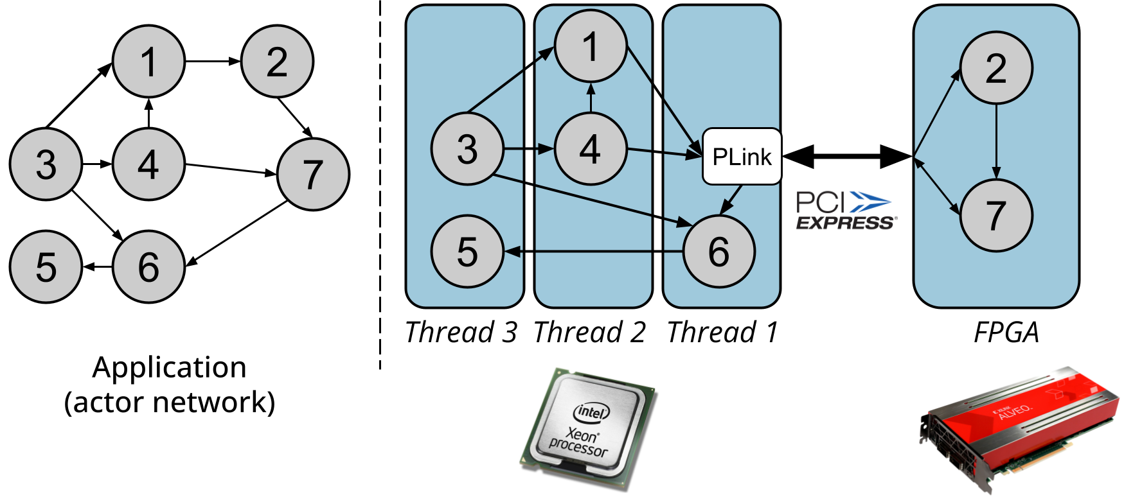
The Problem
Map the application network to CPU threads and the FPGA to maximize performance
Thread parallelism
Spatial parallelism
~ 0.3GHz
~ 3GHz
Notes:
The codesign problem is essentially a hyper-graph partitioning problem, where we need to map the actor network “graph” to the execution graph.
In the execution graph, actors mapped to CPU threads are co-scheduled sequentially, and actors mapped to the FPGA execute in parallel.
A thread or the FPGA make up the partitions and they all execute in parallel.
To come up with a high-performance partition we need to first model the execution time and then find the ones that minimize it.
We do not consider any other objective, such as power or resource utilization in this work.

Slide 10
Solution
Formulate the mapping as a mixed integer-linear programming problem parametrized by profiling information:
Software execution time
Hardware execution time
Intra- and inter-thread communication
PCIe communication
set of actors
Find values of
set of thread and accelerator partitions
Notes:
find values of d_p^a to assign actors to partitions---fairly standard way of MILP formulation.

Slide 11
Modeling Execution Time
Actors on the same thread execute sequentially ⇒ sum up individual execution times
Comes from profiling
both hardware and software
Parallel threads ⇒ execution time dominated by straggler
Accelerator also runs in parallel ⇒ similar to parallel threads
Accelerator time dominated by FPGA straggler (spatial parallel) ⇒ similar to parallel threads
More details in the paper!

Slide 12
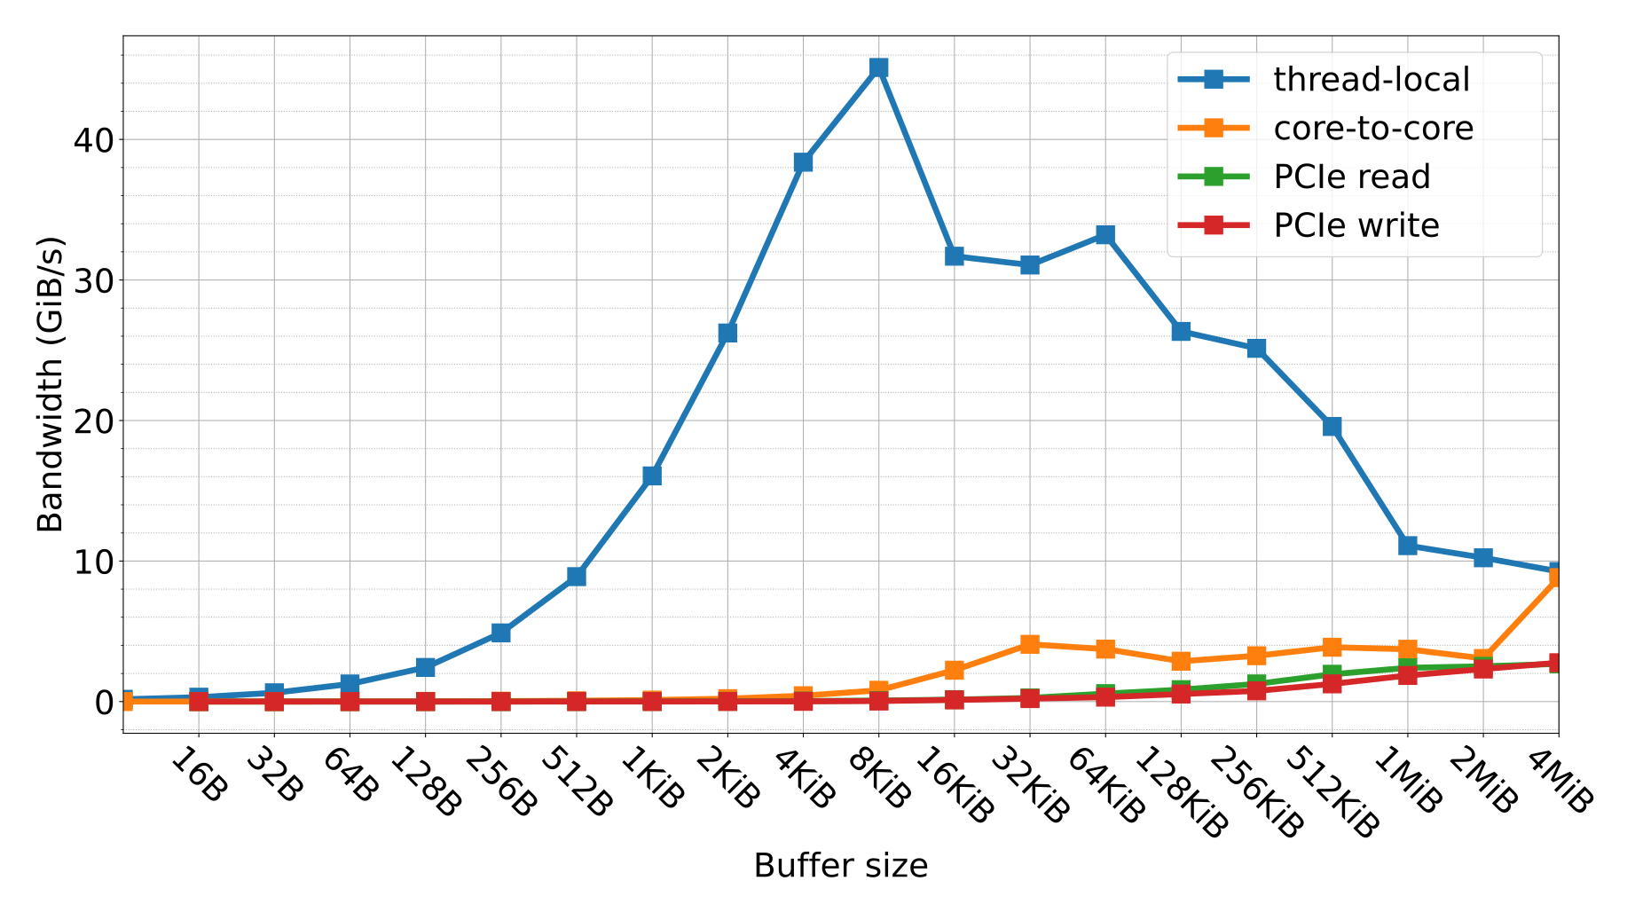
Communication Cost Matters
Can not overlook communication costs ⇒ huge discrepancy
See paper and appendix for full communication cost modeling

Slide 13
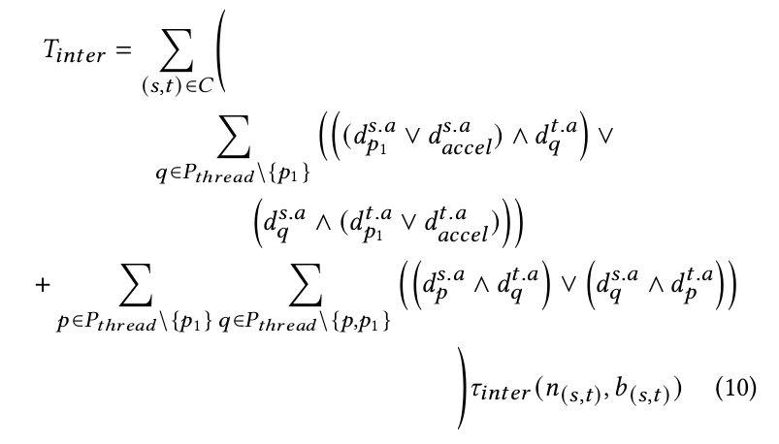
Notes:
immediately skip over this slide

Slide 14
StreamBlocks Compiler

Slide 15
StreamBlocks Overview
CAL to HLS-C & Verilog
Source code
IR
Frontend
configuration file, contains actor to thread/FPGA mapping,
manual or generated
Already discussed
CAL to C++
Notes:
Compilation flow starts with CAL source files
Goes through Tycho, our CAL frontend that operates on its own IR
The IR is then used for code generation of hardware and software
Tanspiles to HLS-C and Verilog for hardware
Transpiles to C++ for software
You can then execute the code, profile it, and give it to the partitioning tool (uses the MILP formulation presented earlier)
Use the new partitions to recompile to potentially accelerate your application

Slide 16
Hardware Backend

Slide 17
Hardware Backend
Generate an HLS implementation of each actor
A C++ HLS class with a streaming interface (hls::stream)
Optimize action selection for HLS
Rely on Vivado HLS (commercial) to handle the rest
Benefit from developments in Vivado HLS
Avoid reverse engineering devices for timing information
Coping with HLS limitations
No support for cycles in dataflow graph
Instantiate HLS actors manually in a Verilog network
Custom parallel dynamic scheduling on hardware ⇒ keep actors active as much as possible, eventually synchronize for termination detection
Lack of support for peeking head of a FIFO
Custom FIFO implementation
Notes:
HLS code of an actor is a c++ class
a “scheduling” method (as the top HLS function) with hls::stream interfaces
Only perform a single action in an invocation to allow HLS tools to optimize the code
Rely on the Vivado HLS to get to Verilog, avoid reinventing the wheel
HLS has limitation
To support cyclic dataflow, independently compile actors to Verilog
Stitch them together outside Vivado HLS in a Verilog network with a parallel scheduling logic (e.g., termination detection)
Extend vanilla hls::stream fifos to handle peeking (reading the head of queue without consuming it)
Required a custom FIFO implementation

Slide 18
Software Backend

Slide 19
Software Backend
Generate a C++ implementation of each actor
Optimize action selection for software
Each actor is a “userspace” thread
Cooperatively schedule multiple actors on a kernel thread (pthread).
Barrier
Barrier
Thread1
Thread2
Thread3
Notes:
Generate C++ class for software
optimize scheduling for software, only yield actor execution when no action can be executed to amortize the cost of scheduling
Each actor is userspace thread,
cooperatively scheduled on a kernel thread (pthread)

Slide 20
Putting it Together
Barrier
redirect software FIFOs to/from FPGA DDR banks
Plink
OCL
Output stage
Input stage
Barrier
Thread1
Thread2
Thread3
Stream from DDR to on-chip FIFOs and vice versa
FPGA DDR
FPGA DDR
FPGA DDR
CPU
FPGA
Notes:
Hardware and software code are linked together using a PartitionLink (PLink) actor.
PLink is an actor instantiated by the compiler
Virtualizes/redirects the cross device FIFOs
Runs on top of standard OpenCL host APIs
Input and Output stage actors are instantiated in hardware
prefetch FIFOs from the FPGA ddr into the on-chip FIFOs
stream on-chip FIFOs to the FPGA ddr

Slide 21
Software-Hardware Interface
FIFOs spanning hardware and software go through to a PLink actor
Internally uses OpenCL host API
DMAs all FIFOs directed to hardware to FPGA DDR
DMAs all FIFOs directed to software from FPGA DDR
All done asynchronously (OpenCL events)
Input stage actors prefetch/stream data from to on-chip FPGA FIFOs in bursts
Output stage actors push on-chip FIFOs to FPGA DDR to be picked up by PLink in bursts

Slide 22
Profiling
Hardware
Cycle-accurate simulation of hardware actors using Verilator
Collect actor and action execution time
PCIe read/write bandwidth
OpenCL profile counters
Software
CPU performance counters (rdtscp) actor execution time
Exchanged traffic between actors in bytes
Software FIFO performance bandwidth
Profiling information is fed to the partitioning tool to find a set of candidate hardware-software partitions

Slide 23
Evaluation

Slide 24
Methodology
Evaluated StreamBlocks on both embedded and datacenter platforms
Datacenter:
Intel Xeon Gold 6234 8-core (16-thread) @ 3.3GHz
Xilinx Alveo U250 (large UltraScale+ FPGA)*
Embedded:
ZCU106 with 4 core ARM64 @1.2GHz (medium sized UltraScale+ FPGA)
Settings and Toolset:
Vivado/Vitis 2019.2
Reduced FPGA buffer size on ZCU106
Hardware-software buffers set to 1Mi tokens
Application:
JPEG decoder + Gaussian Blur, RVC-MPEG4SP decoder
See paper for micro benchmarks.
* Courtesy of AMD’s Heterogeneous Accelerated Compute Clusters (HACC) program

Slide 25
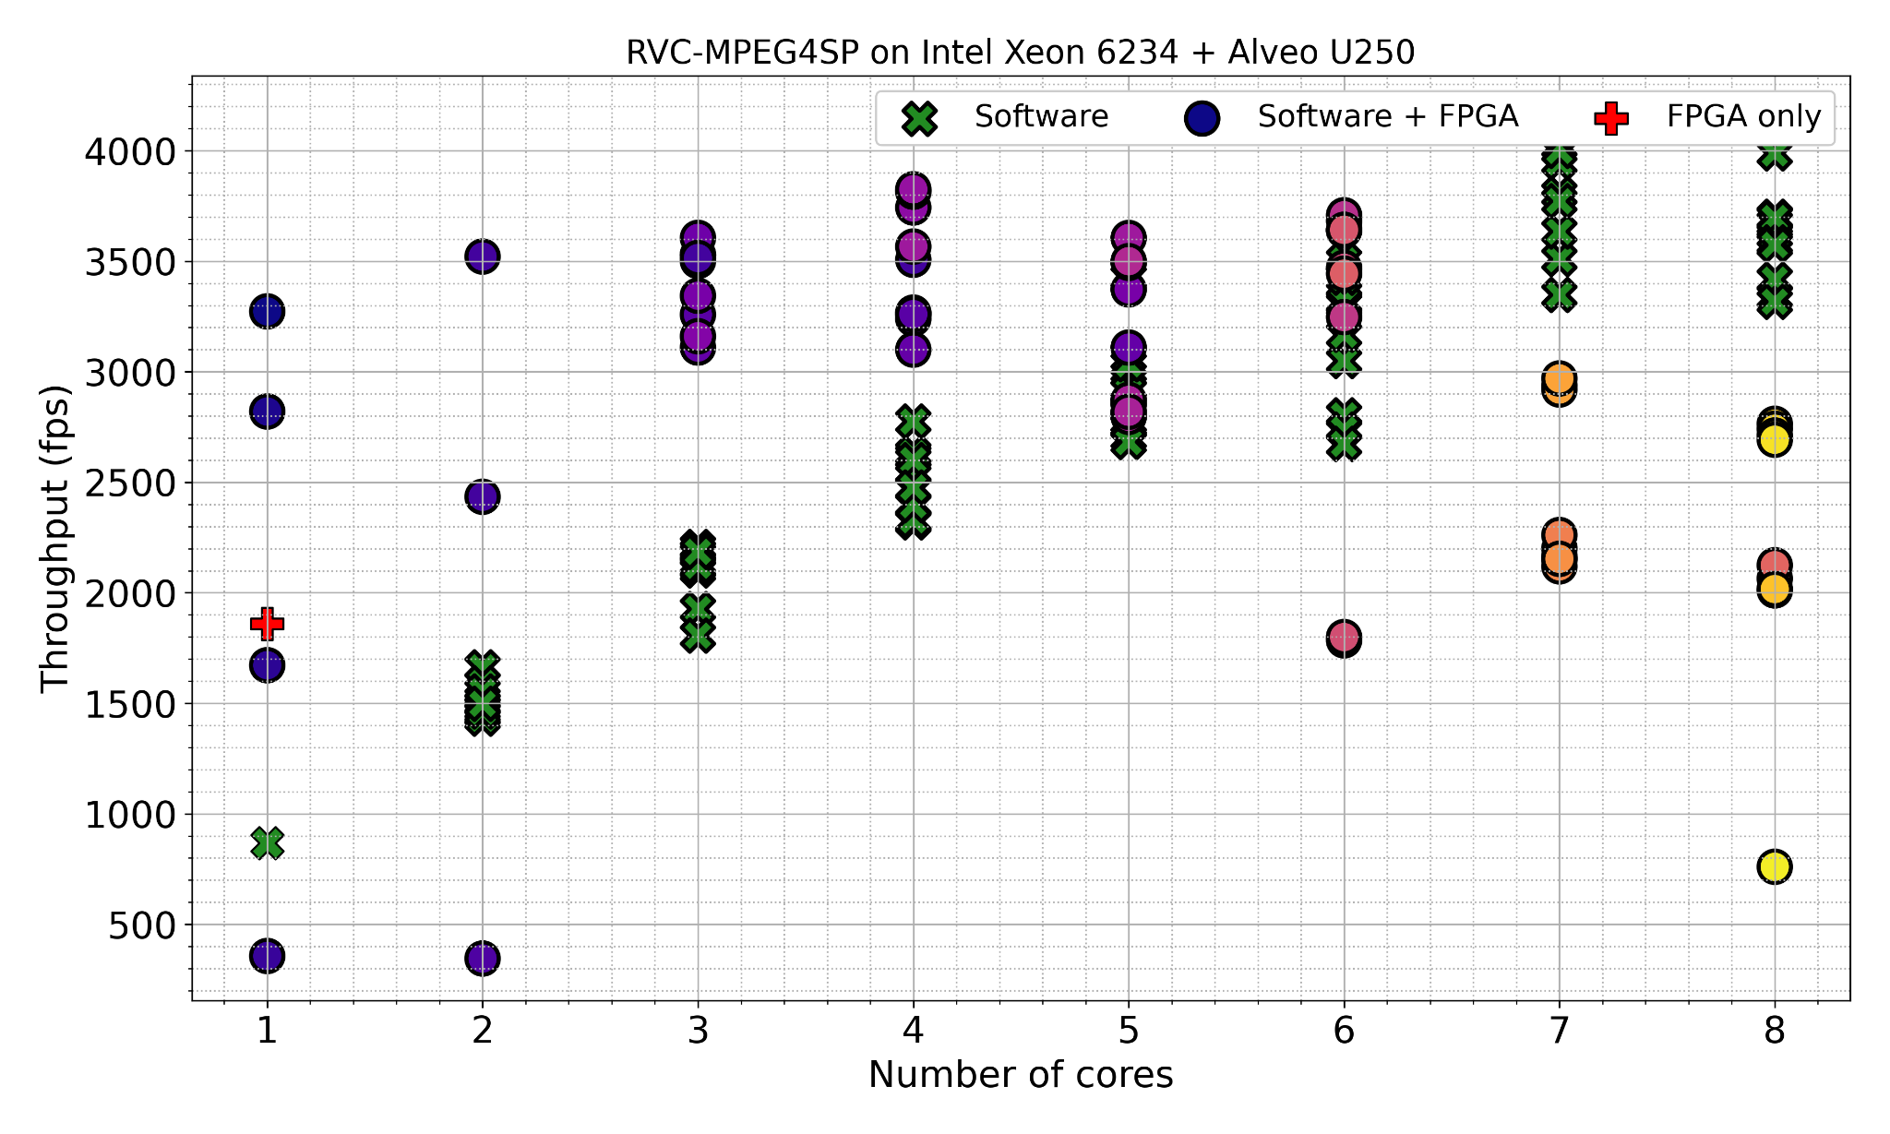
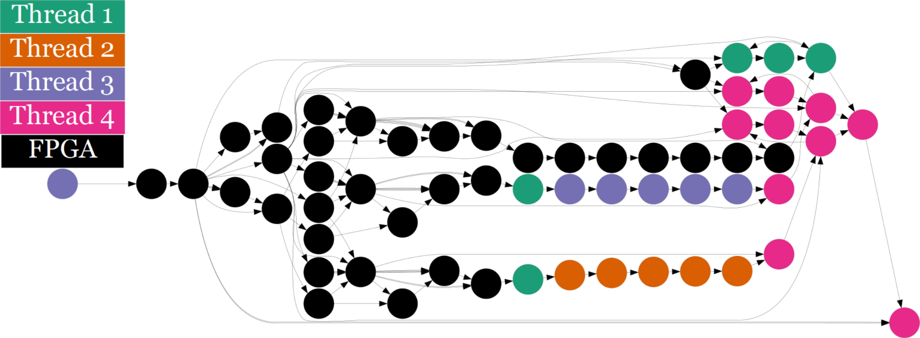
Datacenter (1)
Each color in the software+FPGA set represents a unique set of actors on FPGA

Slide 26
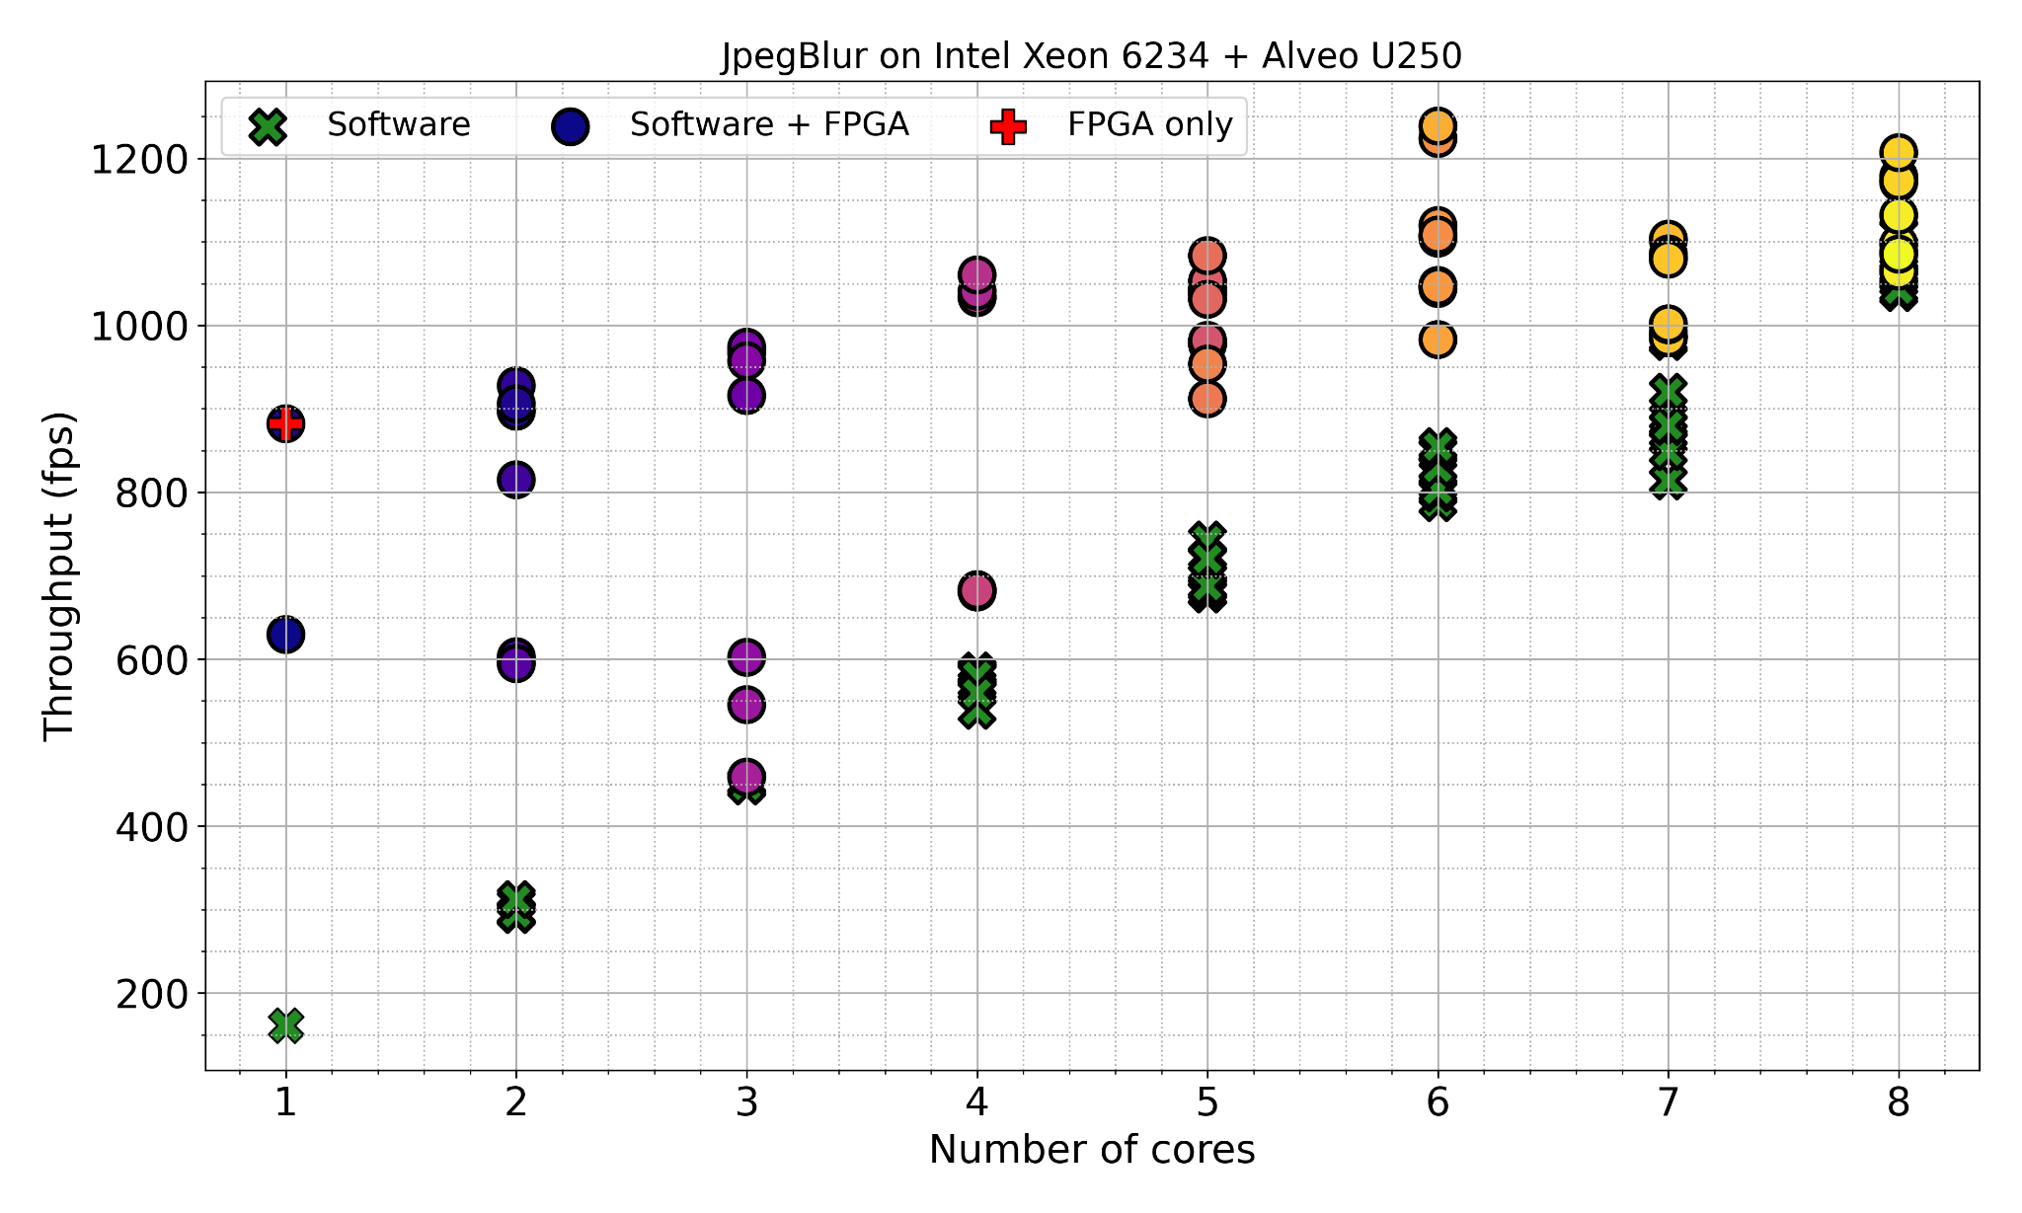
Datacenter (2)
Pure FPGA/CPU execution is not the best solution

Slide 27
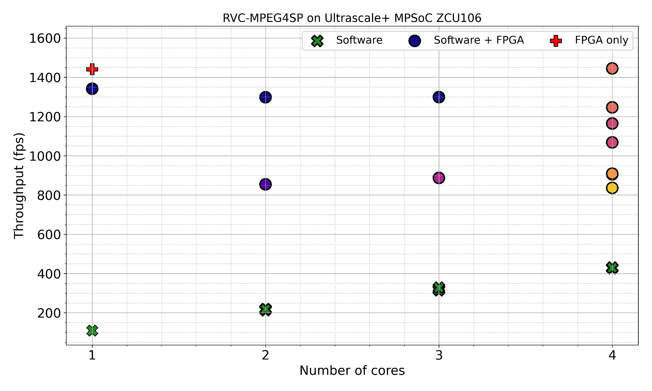
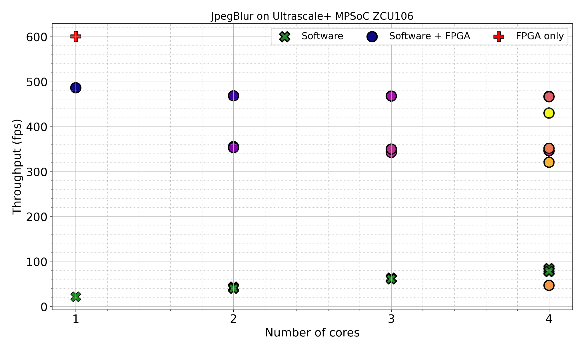
Embedded
Partitioning on embedded systems is less interesting ⇒ Put everything on FPGA

Slide 28
Conclusion
StreamBlocks is a democratic approach for harnessing the power FPGAs in the cloud
Treats FPGAs as any other compute resource
Does not require hardware expertise
Automatic task placement/partitioning with profiling information
Not studied with cloud FPGAs before
Does not reinvent the wheel ⇒ built on top of existing tools
Benefits from future HLS improvements
StreamBlocks is openly available at:
github.com/streamblocks/streamblocks-platforms

